Slide 1
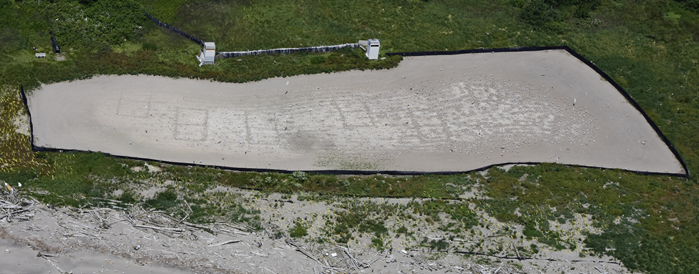
USACE monitoring of Piscivorous birds in the Columbia River Estuary 2022 – Results of Dissuasion and PIT recovery efforts
Fisheries Field Unit
Portland District
Date: 17 JAN 2023
Kyle Tidwell*
Noah Strong
Mark Braun
Bjorn van der Leeuw
Robert Wertheimer

Slide 2
Authority & Scope
East Sand Island :
2020 CRS BA/BiOp – Continue O&M per Caspian Tern (CATE) Mgmt. Plan.
- Provide 1 acre of quality CATE habitat.
- Monitor to ensure there are no more than 4,375 breeding pair.
- Dissuade satellite colonies outside the 1 acre.
2020 CRS BA/BiOp – Continue O&M per Double-Crested Cormorant (DCCO) Mgmt. Plan.
- Provide quality DCCO habitat.
- Monitor to ensure there are no more than 5,939 breeding pair.
Rice, Miller Sands, and Pillar Rock Islands:
2012 Navigation BiOp – Deter piscivorous bird nesting attempts on dredge material islands.
-Monitor and deter all nesting attempts on Rice, Miller, and Pillar Rock islands.

Slide 3
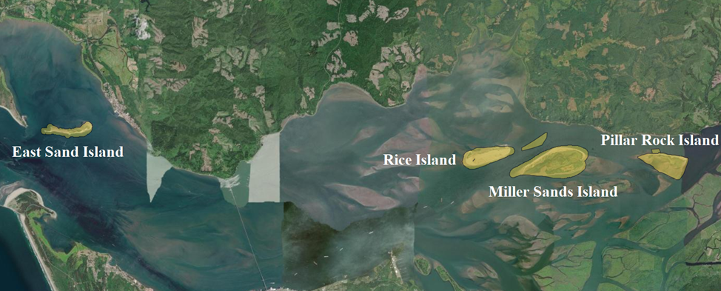
Long term O&M of USACE avian islands
The management of USACE owned and operated islands in the Columbia River estuary is executed by the Fisheries Field Unit. This season we implemented avian monitoring and dissuasion to our full authority to satisfy the requirements of two ESA Section 7(a) consultations (2020 CRS and 2012 Navigation).
We also satisfied regional requests to support PIT recovery efforts on East Sand Island and Rice Island.

Slide 4
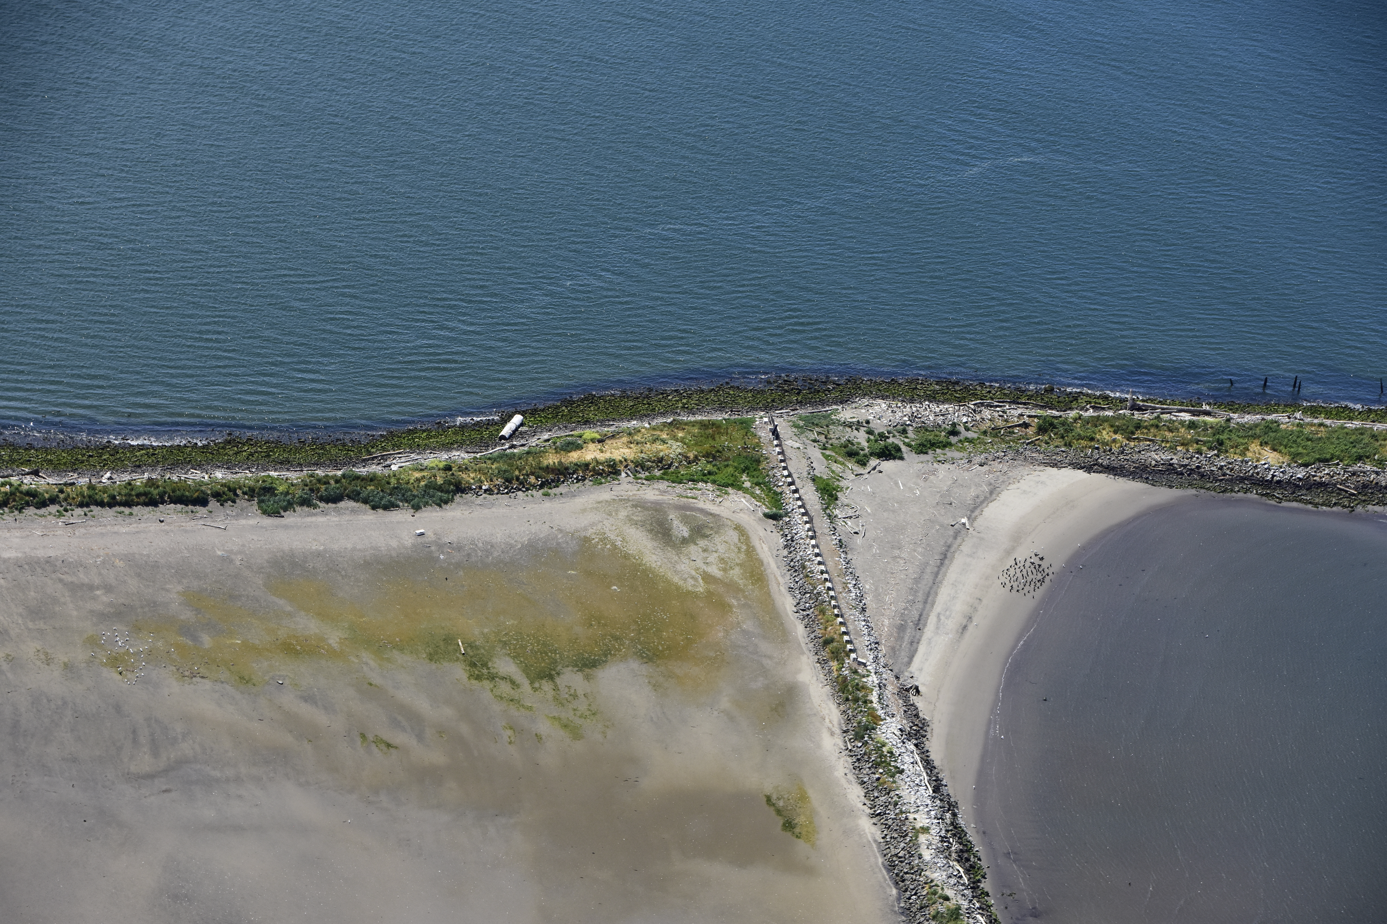
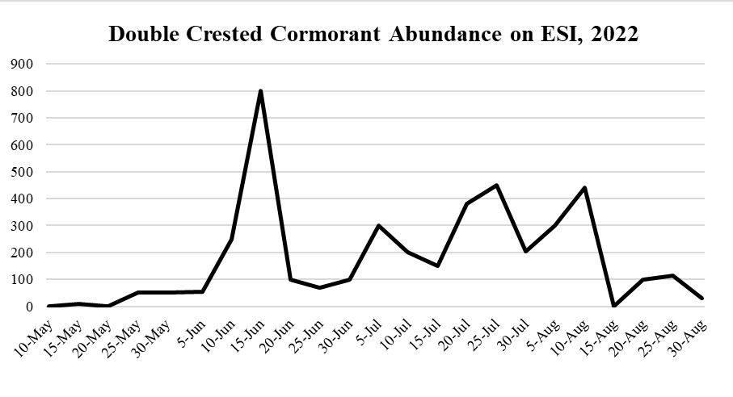
ESI: Double Crested Cormorant
DCCO peak abundance: 2,317 individuals on 23 June (5 flights)
58 confirmed nesting attempts
- No DCCO eggs hatched on ESI
- PIT tags were sown to allow analysis of impact

Slide 5
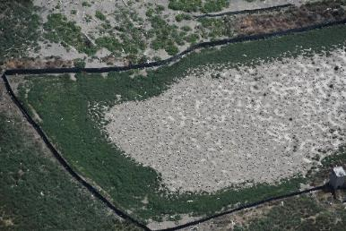
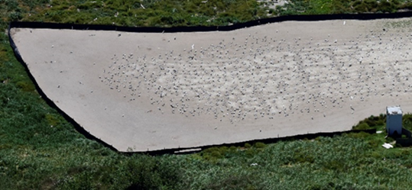
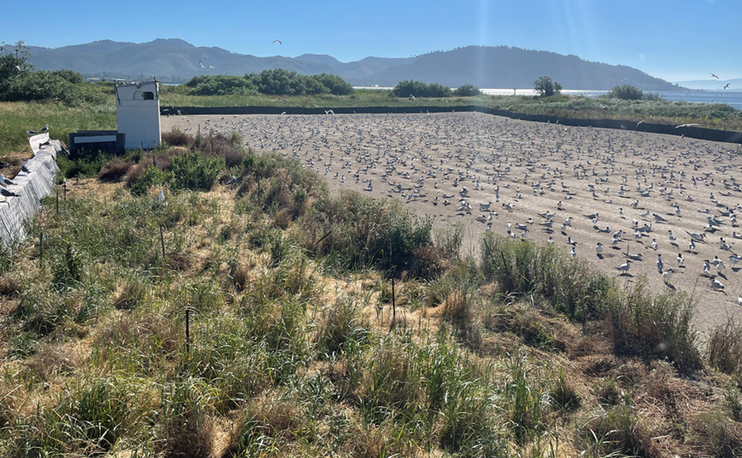
ESI: CATE colony preparation
-- June 21, 2021
-- June 23, 2022
July 19, 2022 --

Slide 6
ESI: CATE monitoring
CATE peak abundance: 1,725 breeding pairs on 20 July (5 flights)
No CATE nests established off colony
No CATE eggs hatched on ESI.
PIT tags were sown to allow analysis
Variable | n days monitored | 𝑥̅ ± S.D | Range | 𝑛 days = 0
Total CATE Abundance on ESI | 36 | 1261.7 ± 1306.7 | 0 - 4035 | 1
Total CATE on Colony | 20 | 1739.9 ± 1241.4 | 0 - 3500 | 1
Total CATE off Colony | 34 | 303.6 ± 241.1 | 0 - 1100 | 1
CATE Scrapes off colony | 14 | 6.5 ± 16.8 | 0 - 58 | 10
CATE Eggs off colony | 14 | 0.6 ± 2.1 | 0 - 8 | 13
CATE Eggs on Colony | 17 | 4.1 ± 12.0 | 0 - 50 | 10

Slide 7
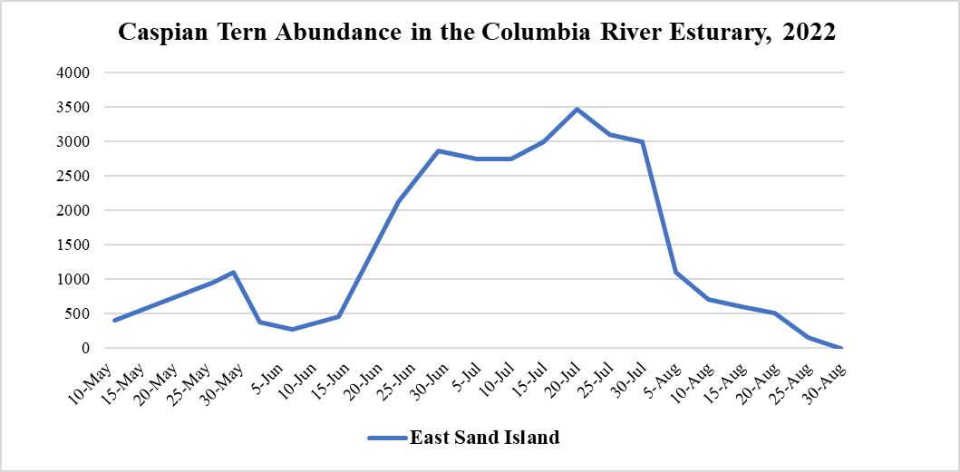

Slide 8
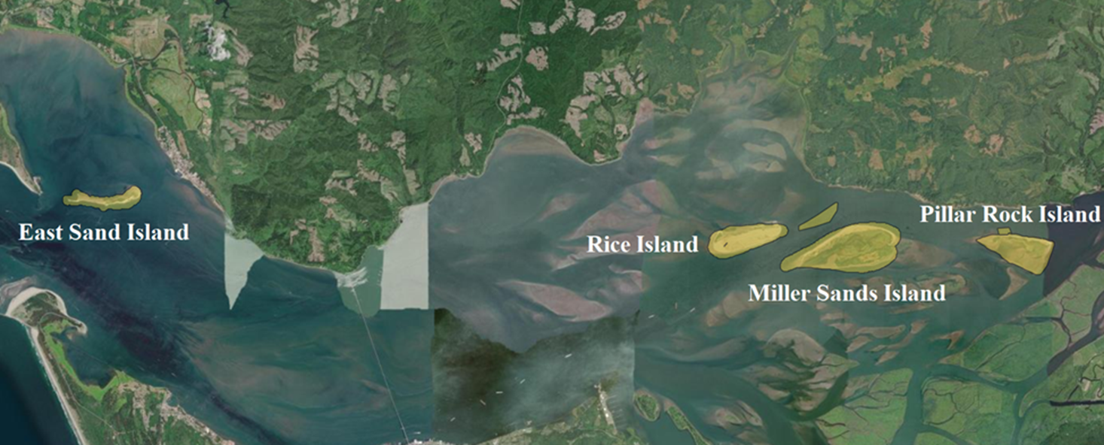
Rice, Miller, Pillar Island

Slide 9
- Incipient CATE colony formed on Rice for 2.5 weeks.
- No eggs hatched
- PIT tags were sown to allow analysis of impact
CATE ABUNDANCE: 5 April – 31 August, 2022 |  | CATE ABUNDANCE, 5 April – 31 August
Site | n days monitored | X̅ ± S.D. | Range | n days = 0
Rice | 44 | 446.68 ± 862.27 | 0-3500 | 6
Miller Sands | 12 | 1.08 ± 3.75 | 0-13 | 11
Pillar Rock | 10 | 2.2 ± 5.94 | 0-19 | 7

Slide 10
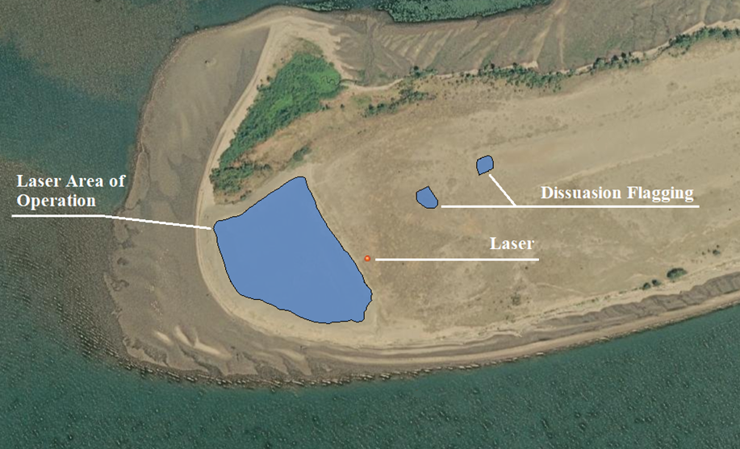
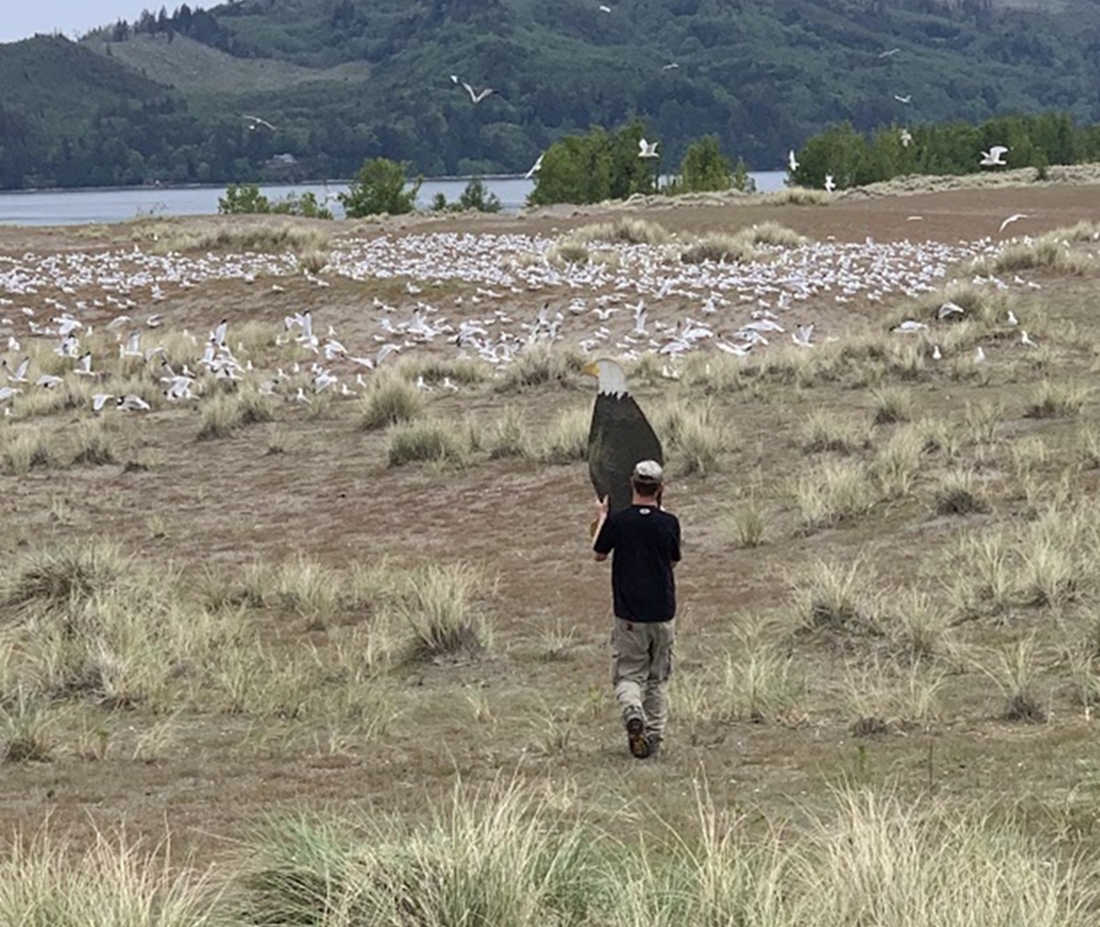
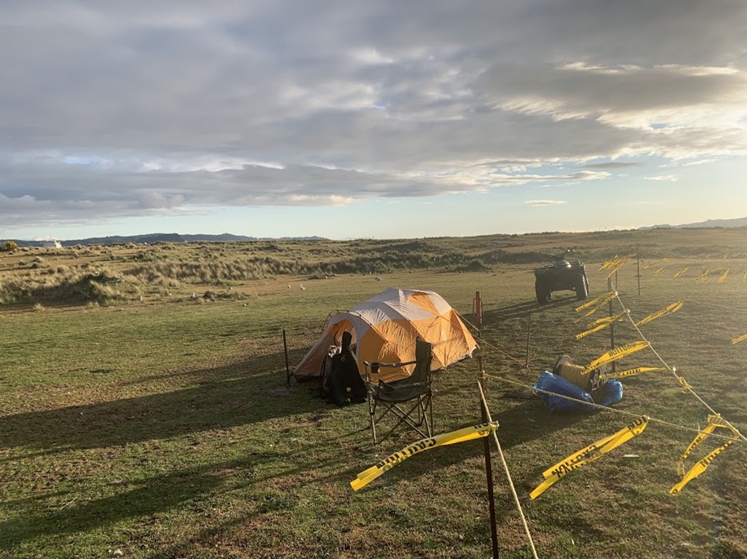
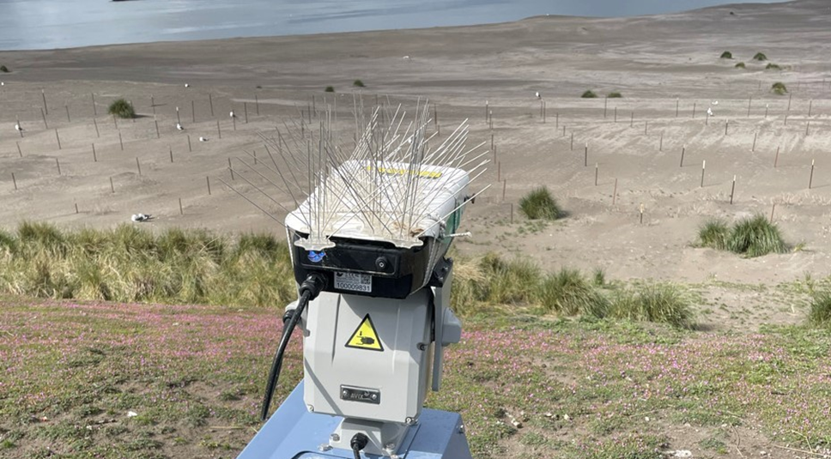
Rice Island
Hazing required to deter incipient CATE colony from Rice Island. Tactics were sensitive to ESA listed Streaked Horned Larks.

Slide 11
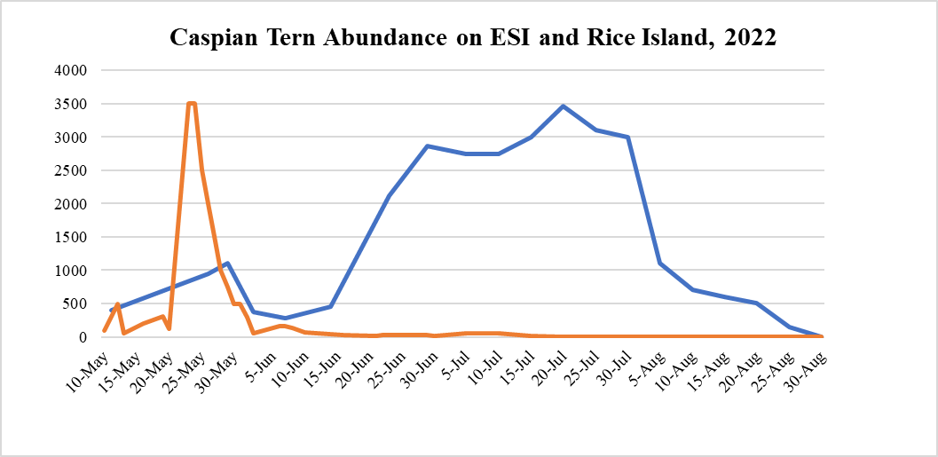

Slide 12
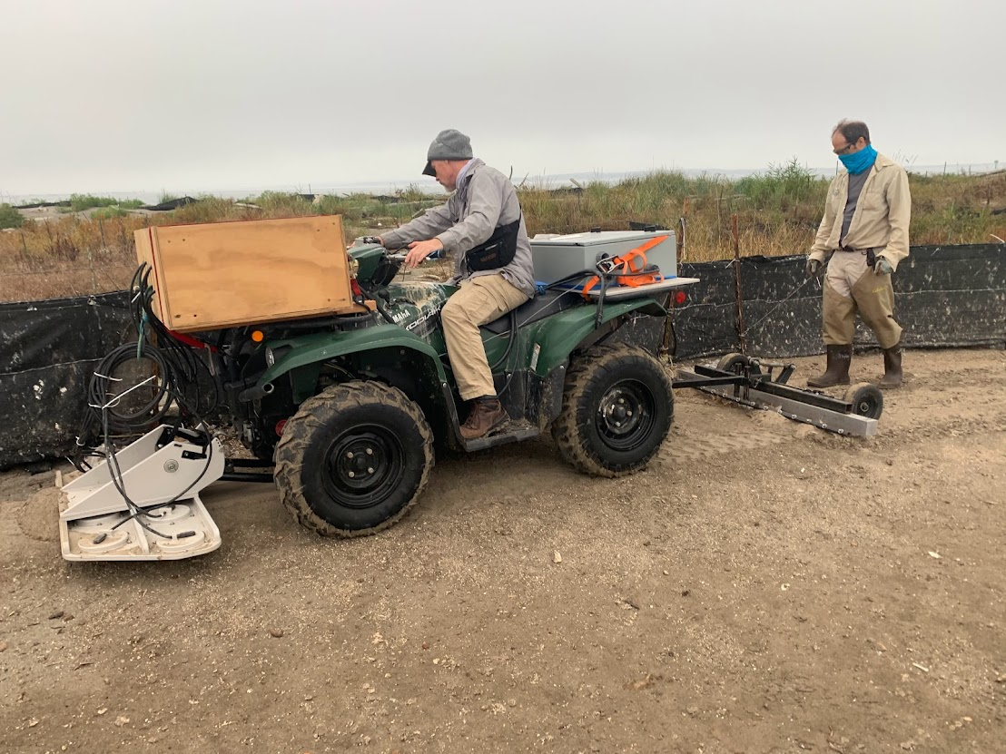
PIT Recovery Efforts –
2022 Migration Year (MY) Smolt Tags Recovered |  |  |  |  |  |  | 2021 MY | 2020 MY
Location | Bird Colony | Chinook | Coho | Steelhead | Sockeye | ALL | ALL | ALL
East Sand Island | DCCO | 63 | 3 | 33 | 0 | 99 | 117 | 38
 | CATE (Colony) | 729 | 102 | 793 | 12 | 1,636 | 4,218 | 3,705
 | CATE (Off-colony) | 70 | 8 | 9 | 1 | 88 | 849 | 890
Rice Island | CATE (Incipient)* | 602 | 17 | 1,740 | 26 | 2,385 | NA | 293
* Real Time Research supported Rice Island PIT collection.
Salmonid Impact = 2.5 weeks of CATE on Rice > 6 months of CATE on ESI

Slide 13
Closing remarks
Met management objectives and maintained compliance with ESA requirements across all USACE owned and operated islands.
Required intense dissuasion efforts by FFU staff.
Rice Island incipient CATE colony had a large impact on steelhead.
A result of staffing issues and mechanical issues that have been addressed.
CATE colony on ESI has changed over the last four years. Management of habitat and CATE are ongoing regional discussions.
Minimal DCCO nesting on ESI despite abatement of hazing and quality habitat.
Continue to manage land and prepare for DCCO to return.

Slide 14
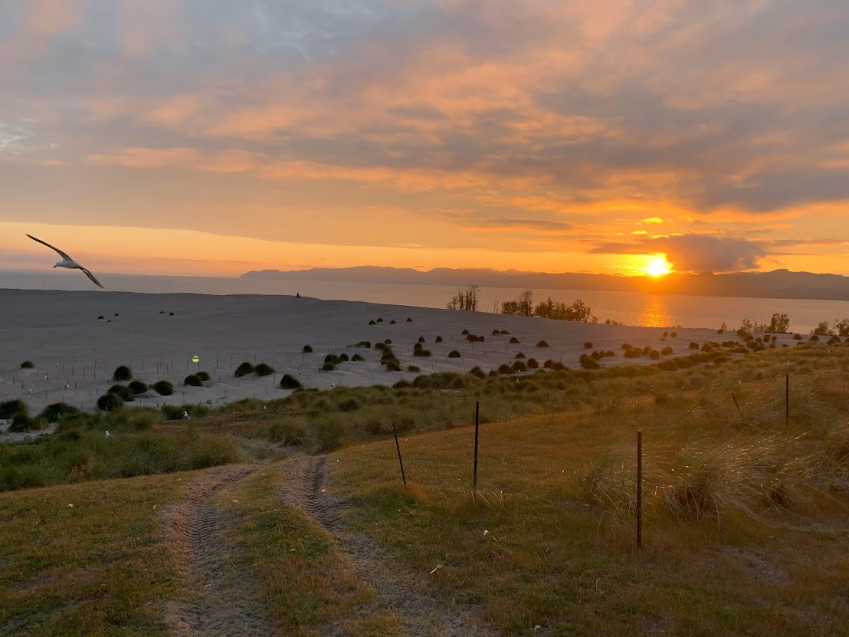
Questions?
FFU POC: Kyle.S.Tidwell@usace.army.mil

Slide 16
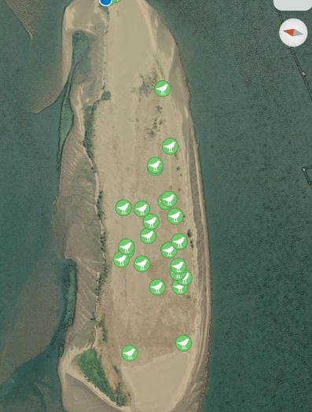
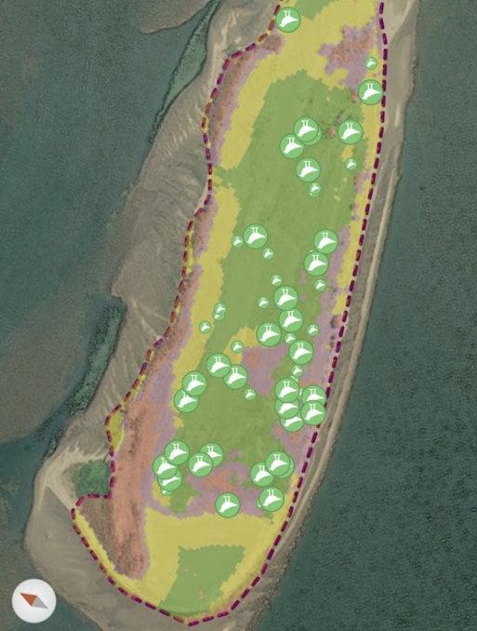
2012 Nav BiOp –
SHLA Impact?
Coordination with USFW:
USF&W could not allow:
- Pyro/cannons (SHLA impact)
- Increased CATE egg take
RBGU egg take
Laser use mainland
SHLA Distribution May 24
SHLA Distribution June 8

Slide 17
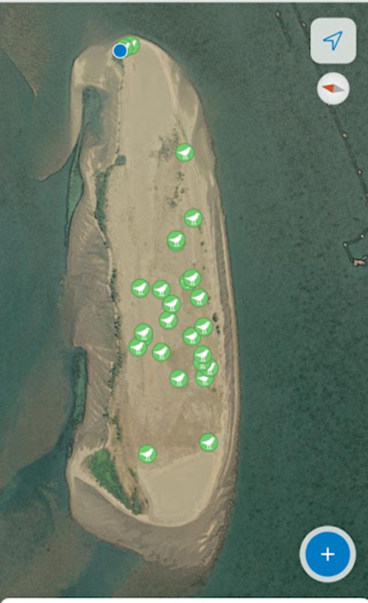
Streaked Horned Lark Impact?
2014 BiOp
“……This activity is a requirement in the National Marine Fisheries Service’s 2012 Biological Opinion to the Corps (Term and Condition 1(k)) specifying that if piscivorous birds are identified in the action area, hazing actions must be implemented to intentionally flush birds and discourage nesting on upland placement sites…”
Coordination with USFW:
- SHLA displacement ~ CATE Colony
- USFWS could not allow:
Pyro/cannons (SHLA impact)
Increased CATE egg take
RBGU egg take
-

